Slide 1
Legal Data Analysis
Final Project
Kiana Saint-Macary & Elena Susini

Slide 2
Research question
How does the subject matter of the complaint influence the length of the proceedings and the final conclusions of the ECHR?
“How long do proceedings before the Court usually last?
It is impossible to indicate the length of proceedings before the Court. The Court endeavours to deal with cases within three years after they are brought, but the examination of some cases can take longer and some can be processed more rapidly.
The length of the proceedings before the Court obviously varies depending on the case, the formation to which it is assigned, the diligence of the parties in providing the Court with information and many other factors, such as the holding of a hearing or referral to the Grand Chamber.
Some applications may be classified as urgent and handled on a priority basis, especially in cases where the applicant is alleged to be facing an imminent threat of physical harm. “
European Court of Human Rights: The ECHR in 50 questions, 2021

Slide 3
Approach
Collecting Data
Pull judgments from open data ECHR dataset
Scrape judgment for the date the complaint was lodged
Create a dataset with the following factors:
Articles
Subarticle(s)
Start date (date the complaint was lodged)
End date (date of the judgment)
Importance
Conclusions
Number of associated articles

Slide 4
Approach
Analyzing Data
Calculate the length in months of proceedings, based on:
Start date
End date
Compare length of proceedings in months, based on:
Case importance - ranked 1 through 4
Conclusions - violation or no violation
Start date - before or after 2015
Category of article
different human rights violations
articles 2 to 18

Slide 5
The Process

Slide 6
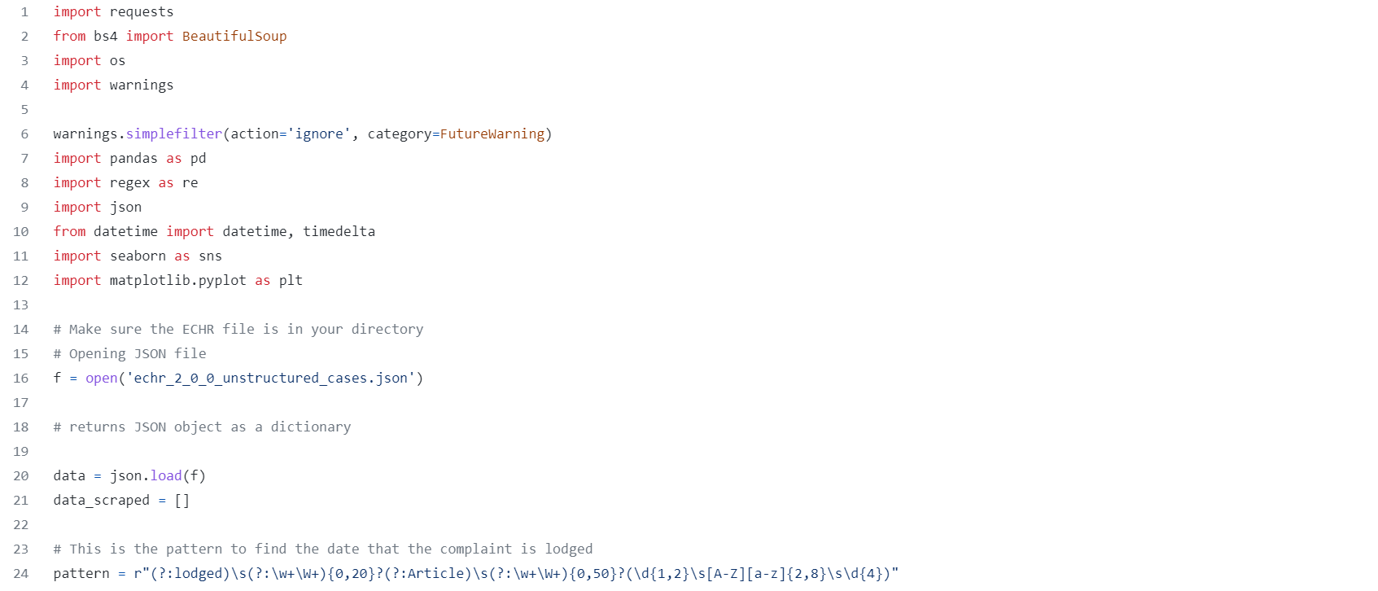

Slide 7
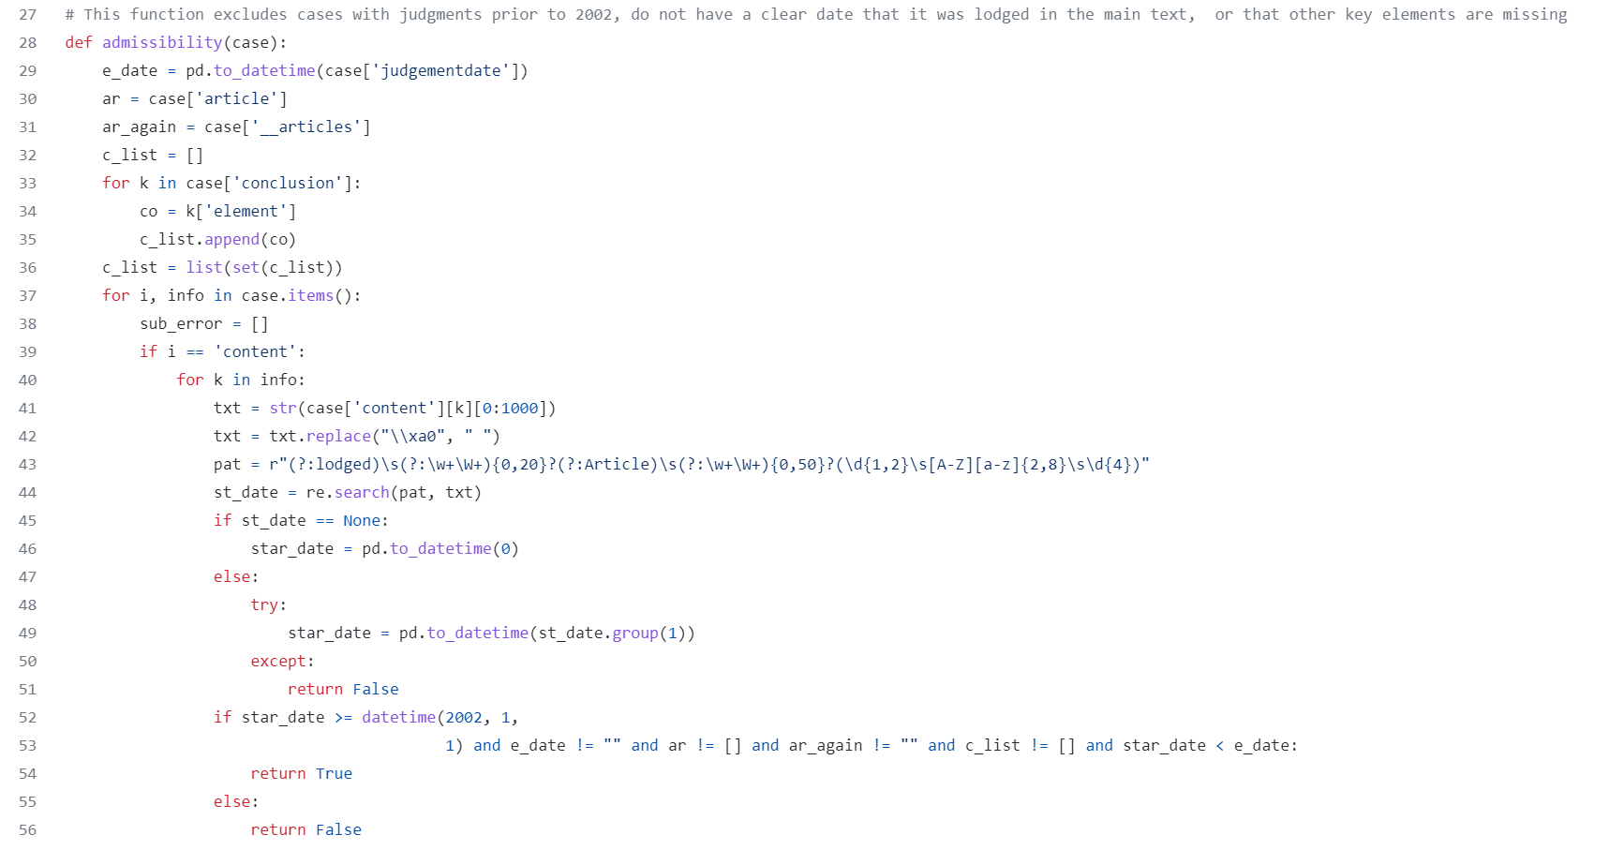

Slide 8
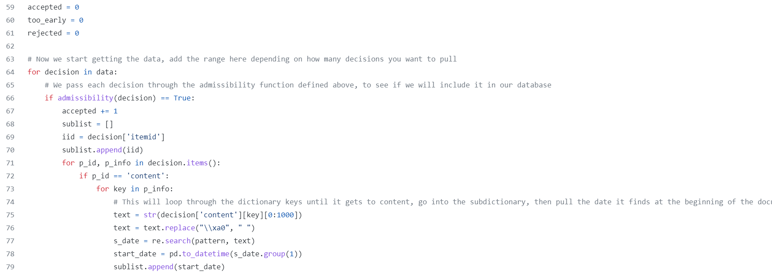

Slide 9
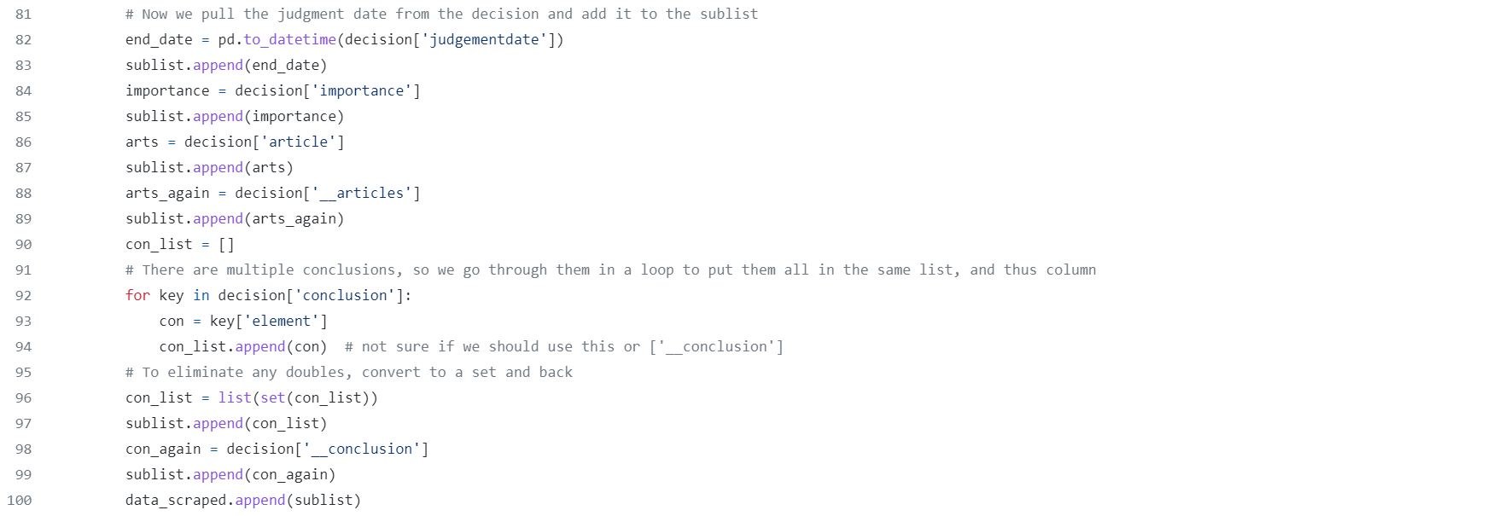


Slide 10
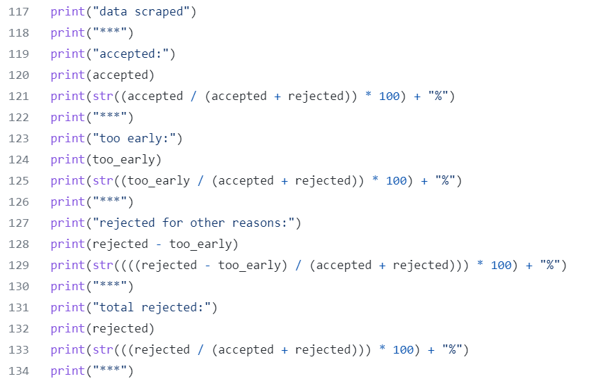
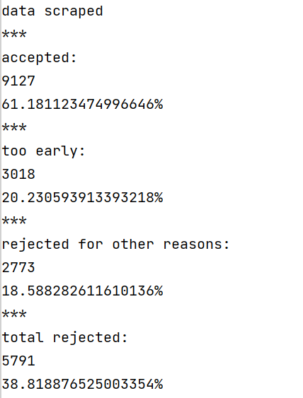

Slide 11
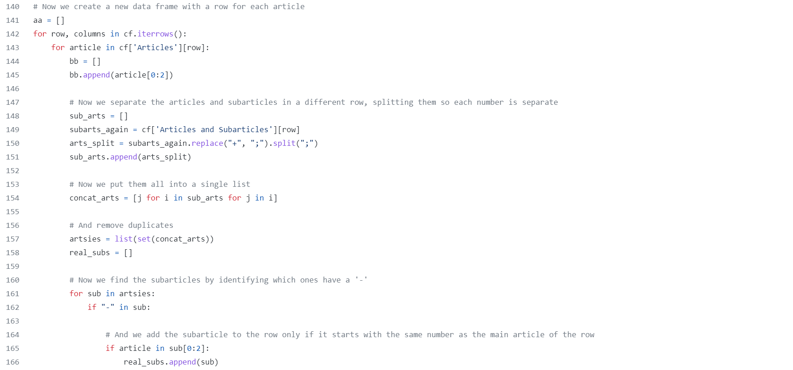

Slide 12
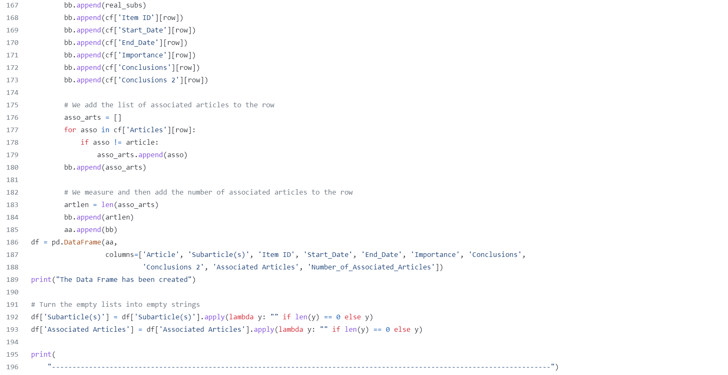

Slide 13
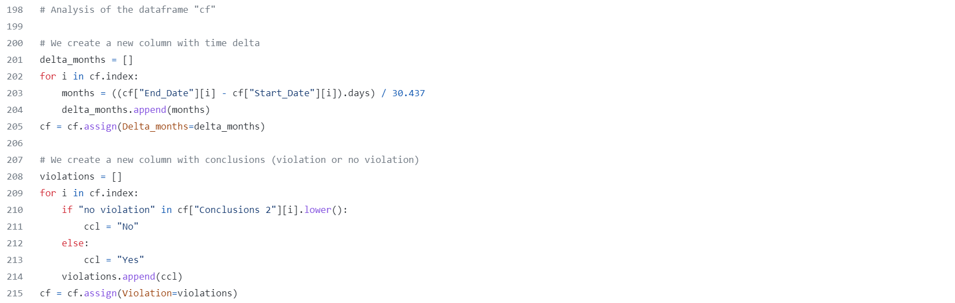
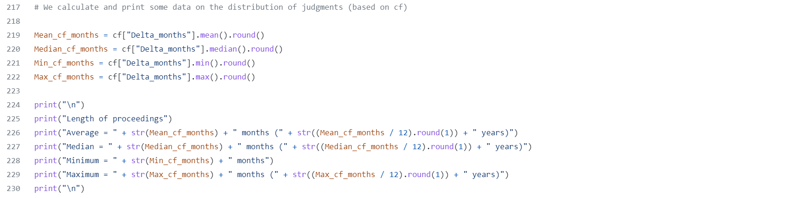

Slide 14
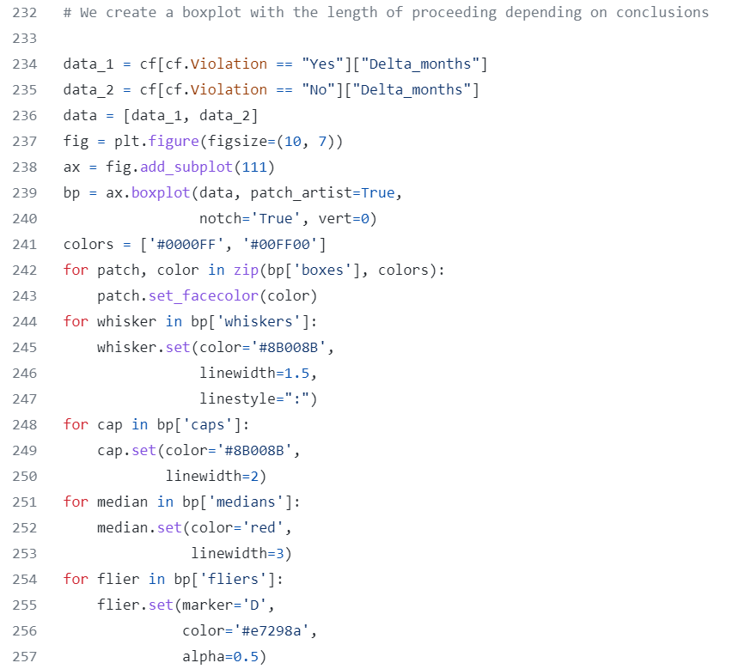
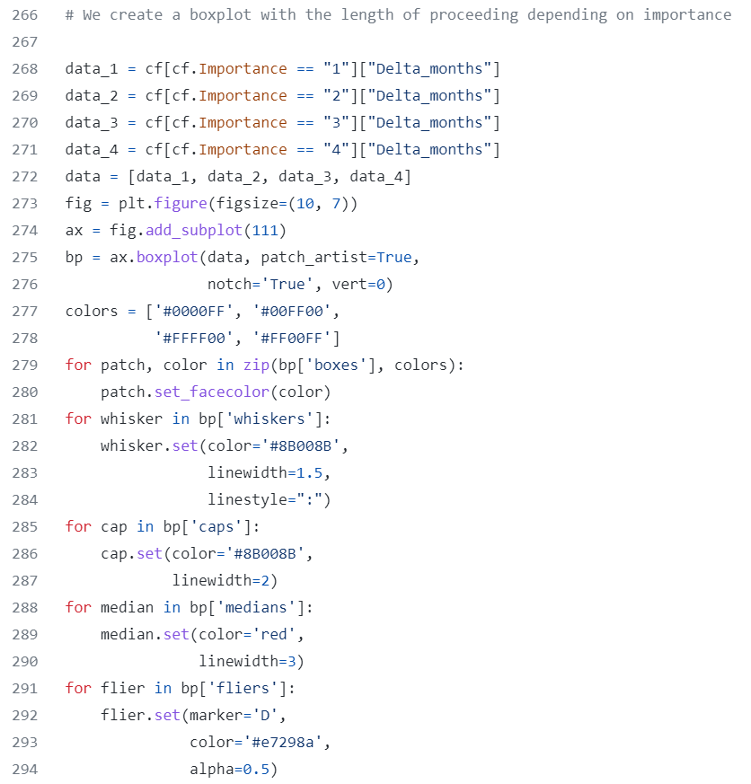
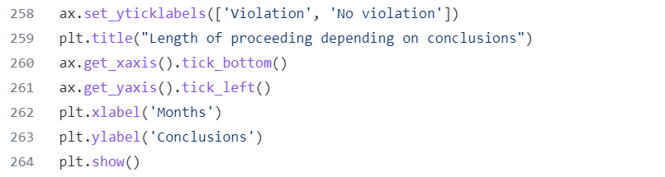
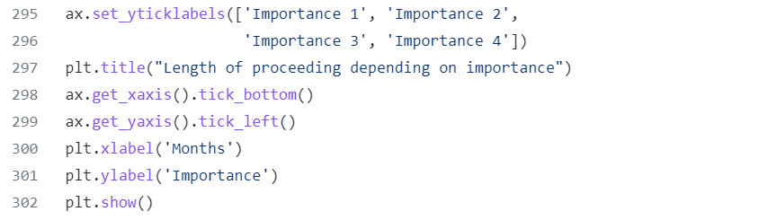

Slide 15
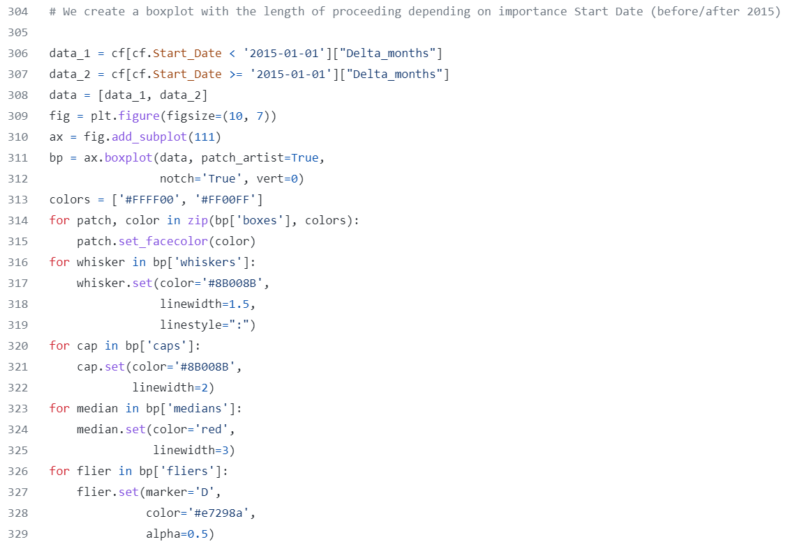
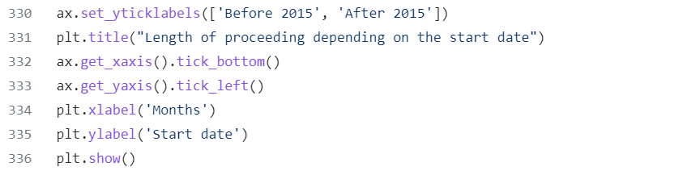

Slide 16
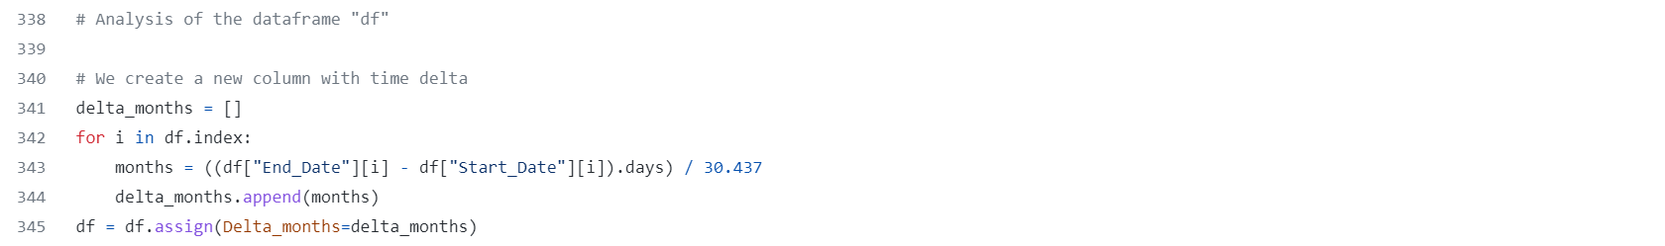
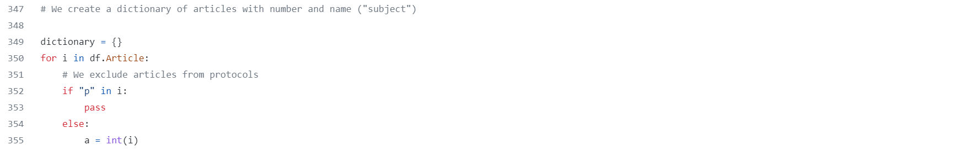
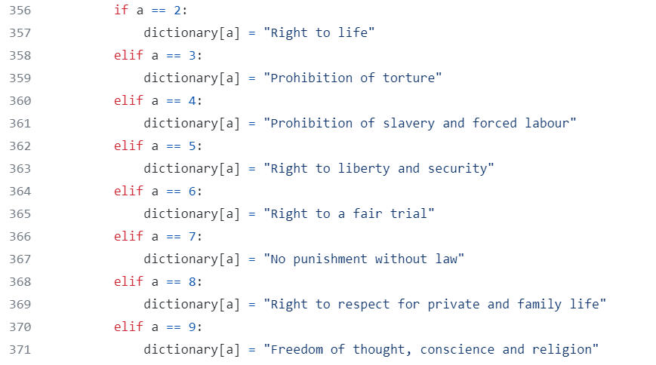
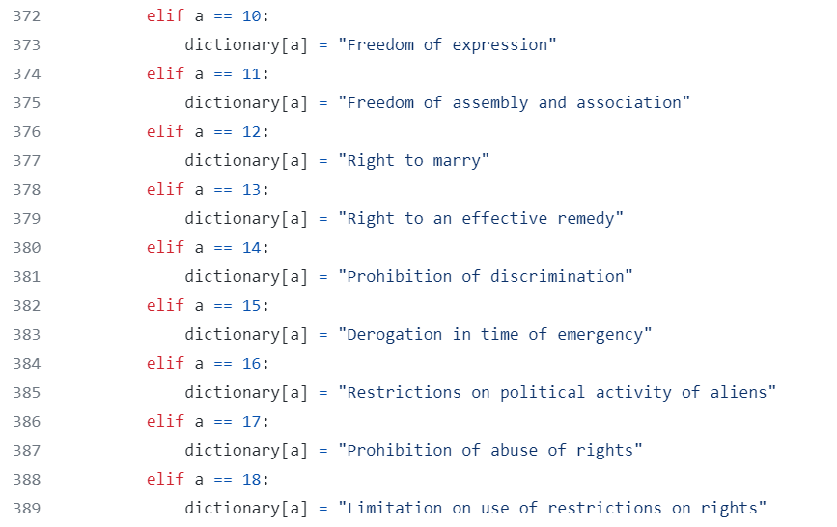
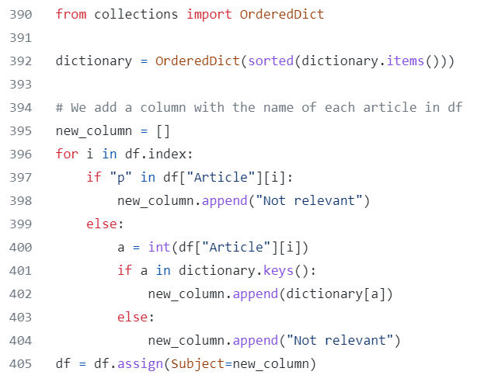

Slide 17
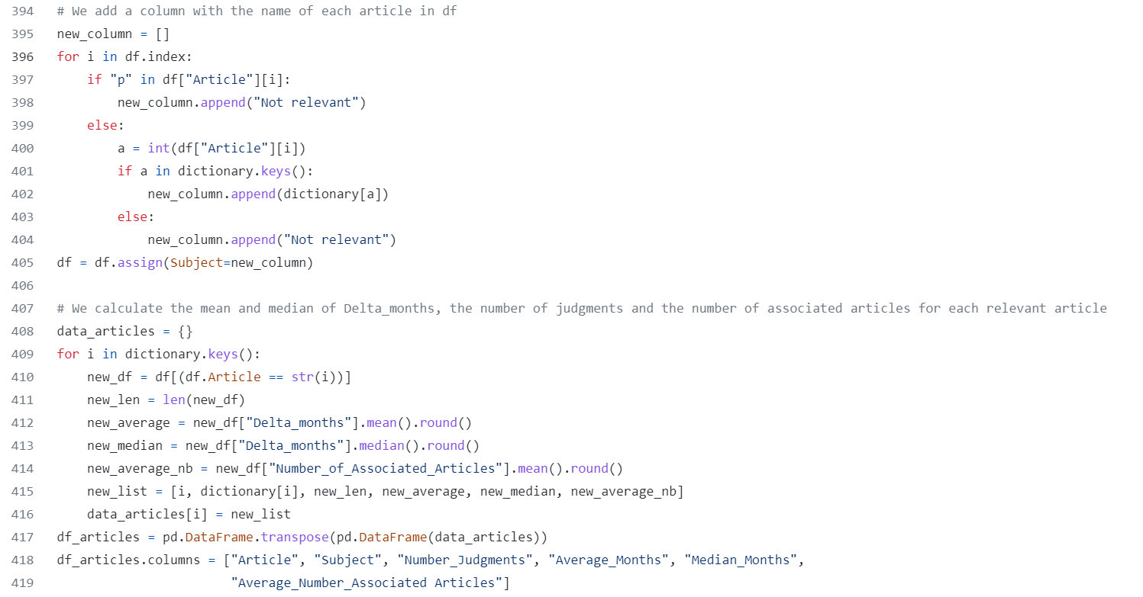
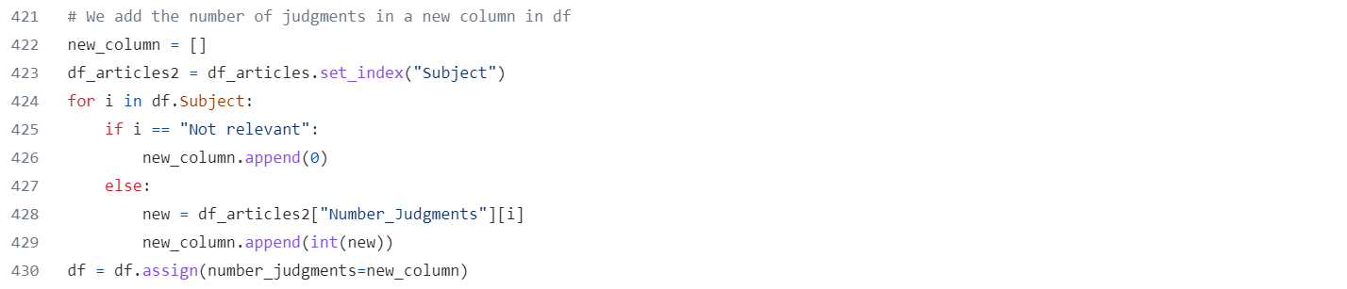

Slide 18
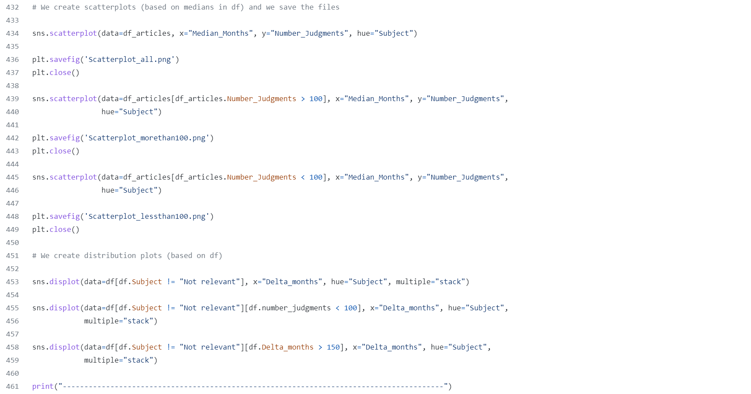

Slide 19
The Results

Slide 20
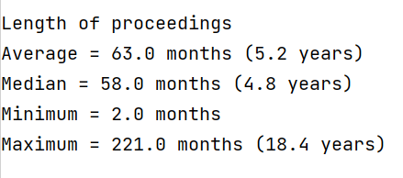

Slide 21
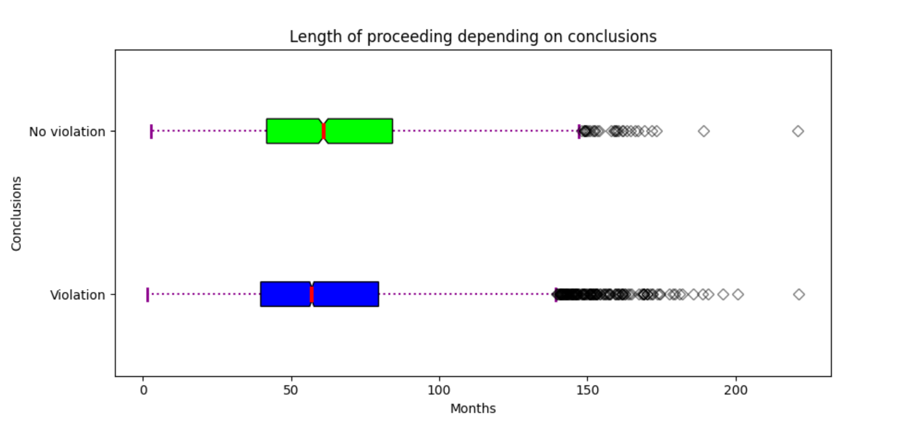
The ECHR responds slightly more quickly when there is a violation.

Slide 22
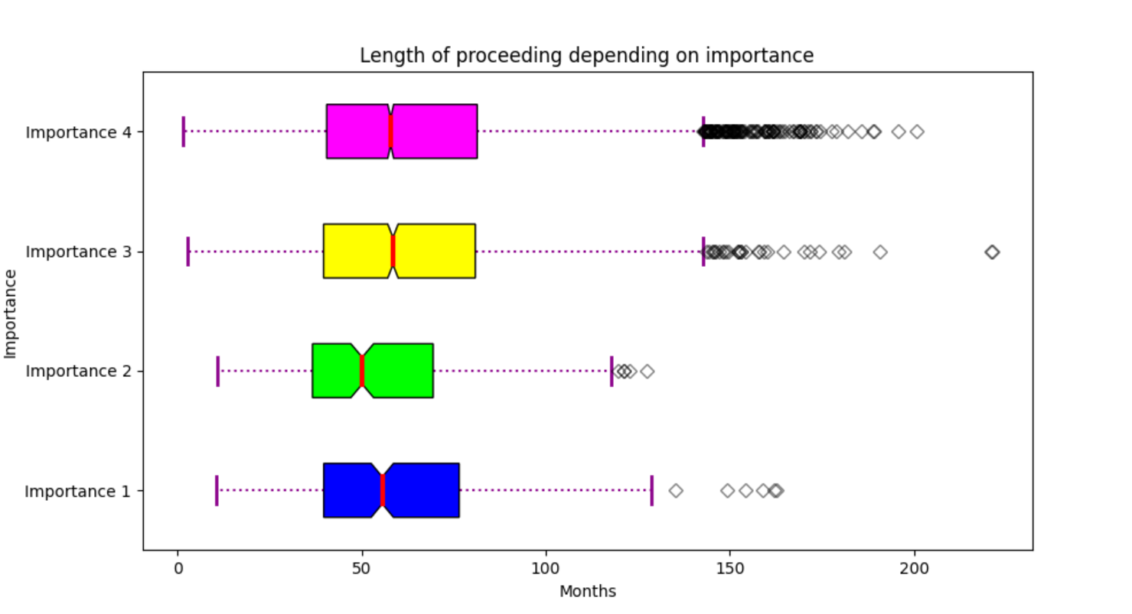
The ECHR responds slightly more quickly for cases of higher importance.

Slide 23
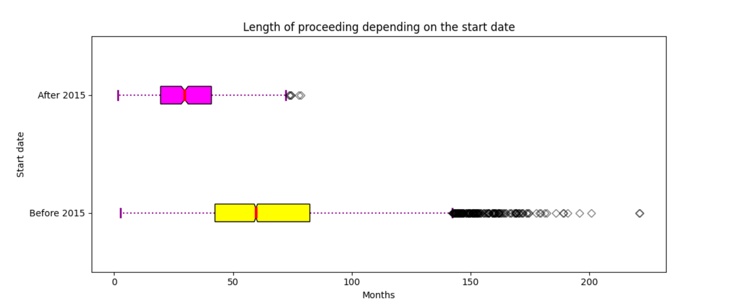
A massive increase in the number of requests in 2011 led the ECHR to change its method : proceedings are faster after 2015. (https://www.rue89strasbourg.com/parcours-requetes-cour-europeenne-des-droits-homme-125332)
(N.B: The procedure has a maximum duration of 84 months if the complaint was filed in 2015)

Slide 24
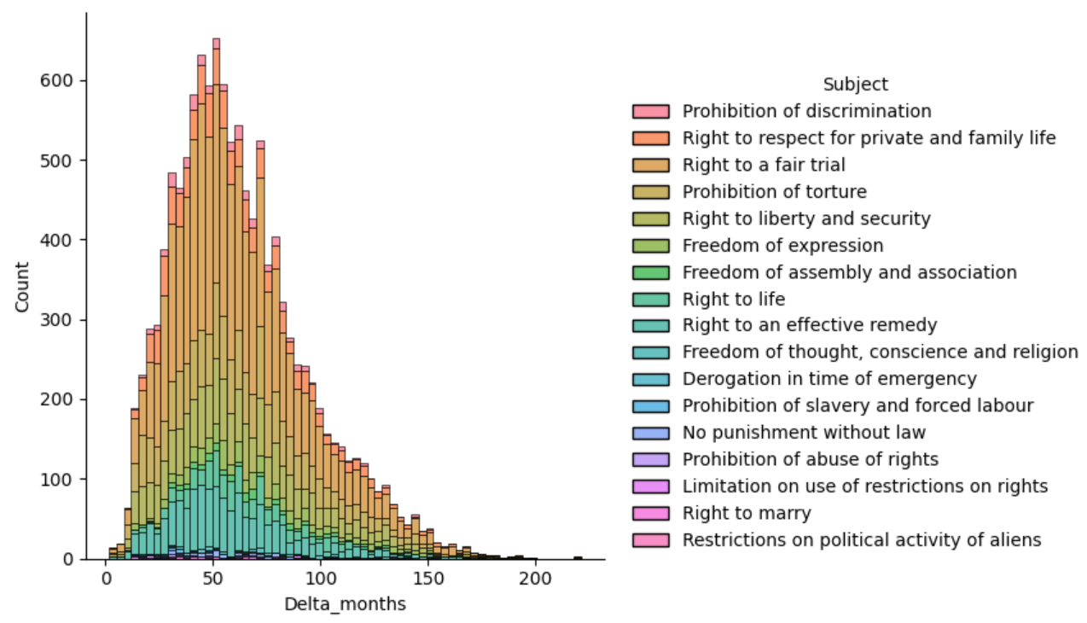

Slide 26
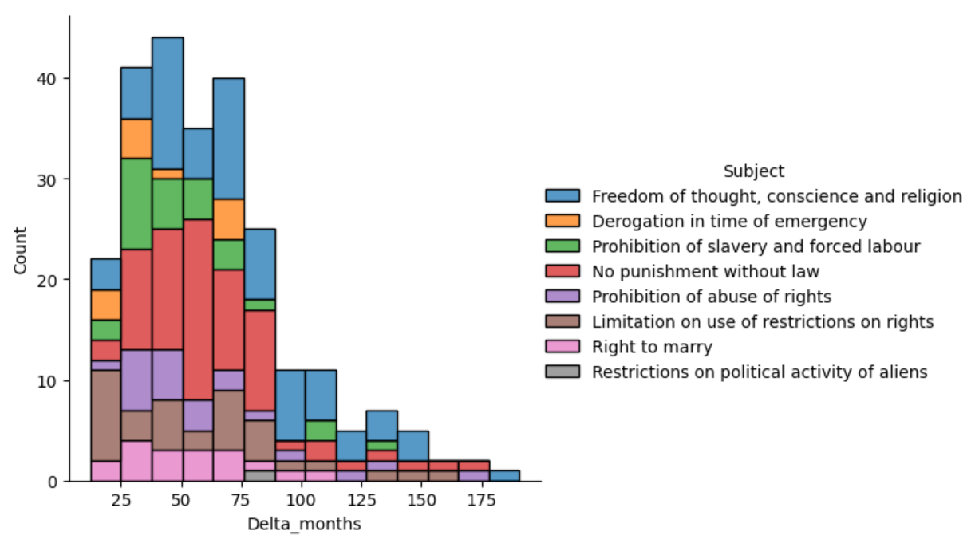
Faster proceedings: derogation in time of emergency, prohibition of slavery, right to marry

Slide 28
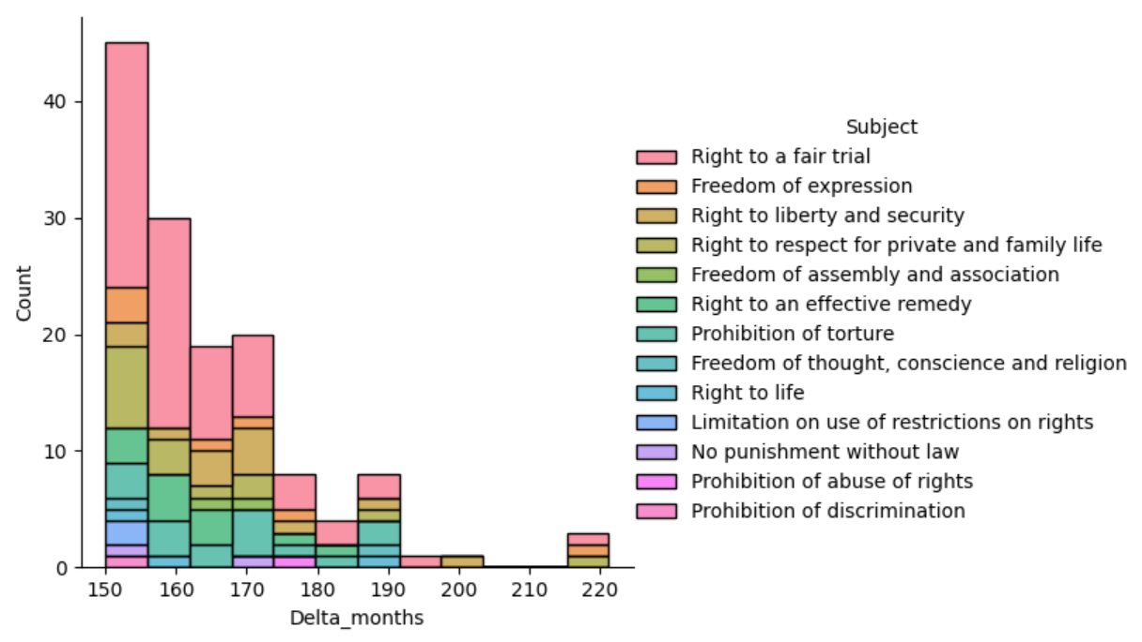
Two 18 years proceedings : article 6 (right to a fair trial) ; articles 8 (right to respect for private life) and 10 (freedom of expression)

Slide 29
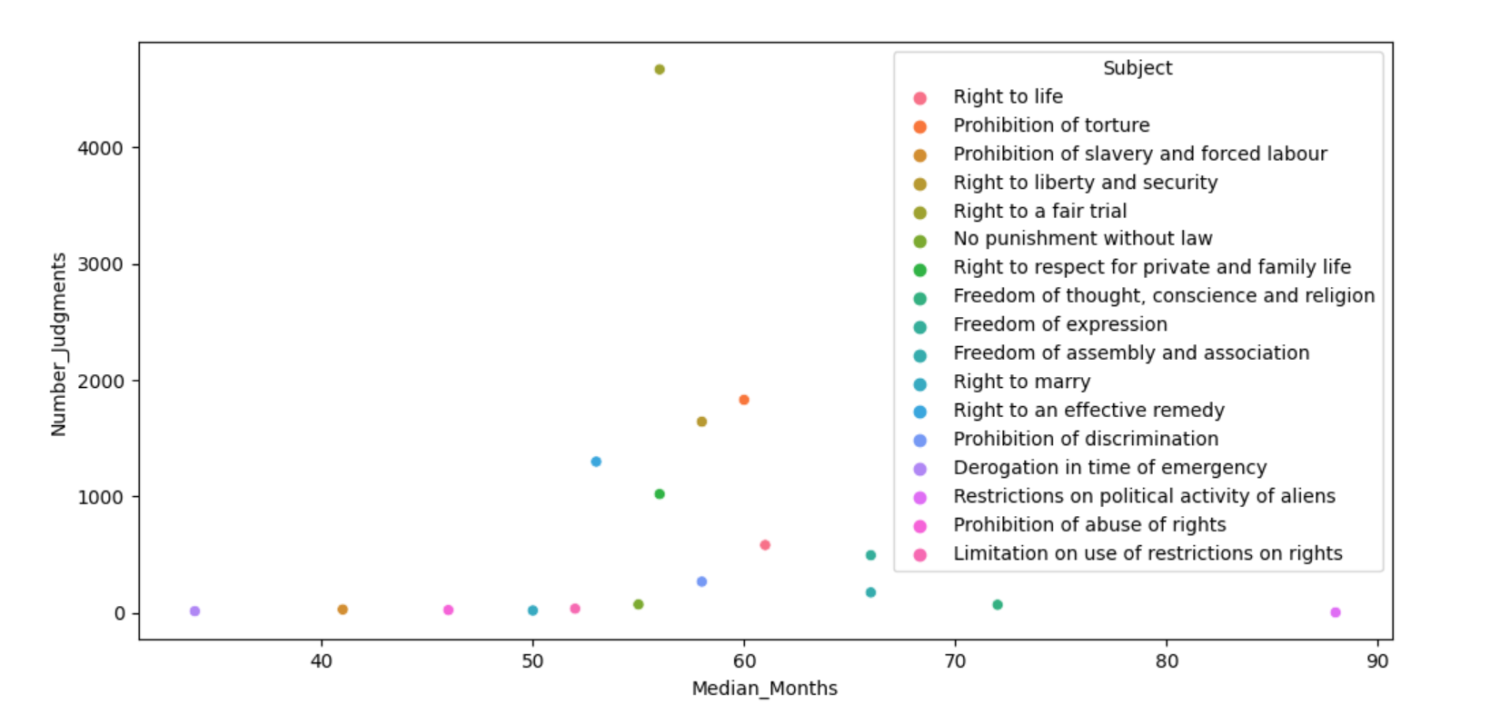
Faster proceedings : derogation in time of emergency (34), prohibition of slavery (41), prohibition of abuse of rights (46)
Longer proceedings : restrictions on political activity of aliens (88, 1 judgment), freedom of thought (72), freedom of expression (66), freedom of assembly (66)

Slide 31
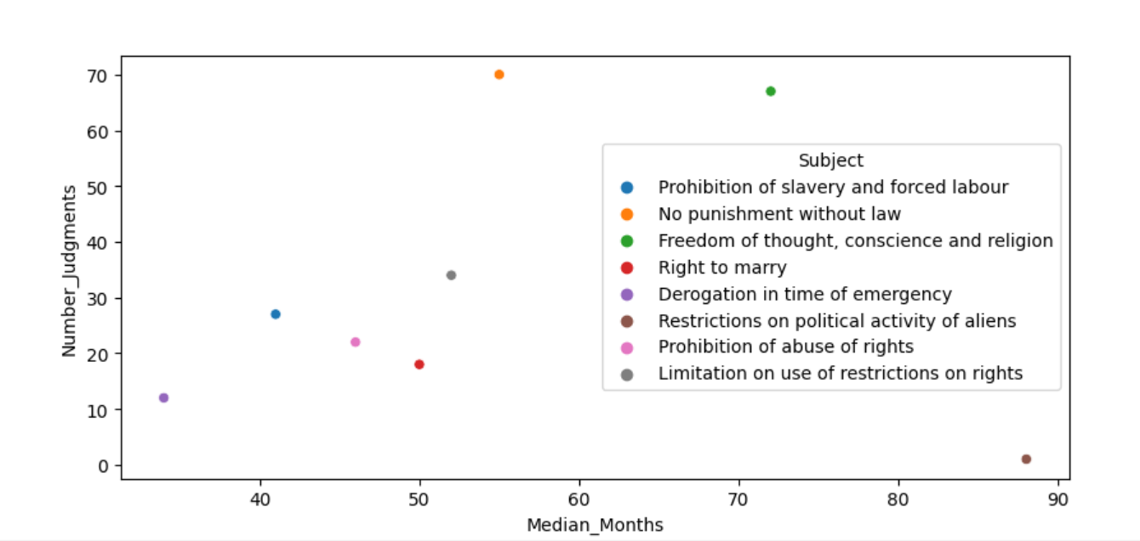

Slide 33
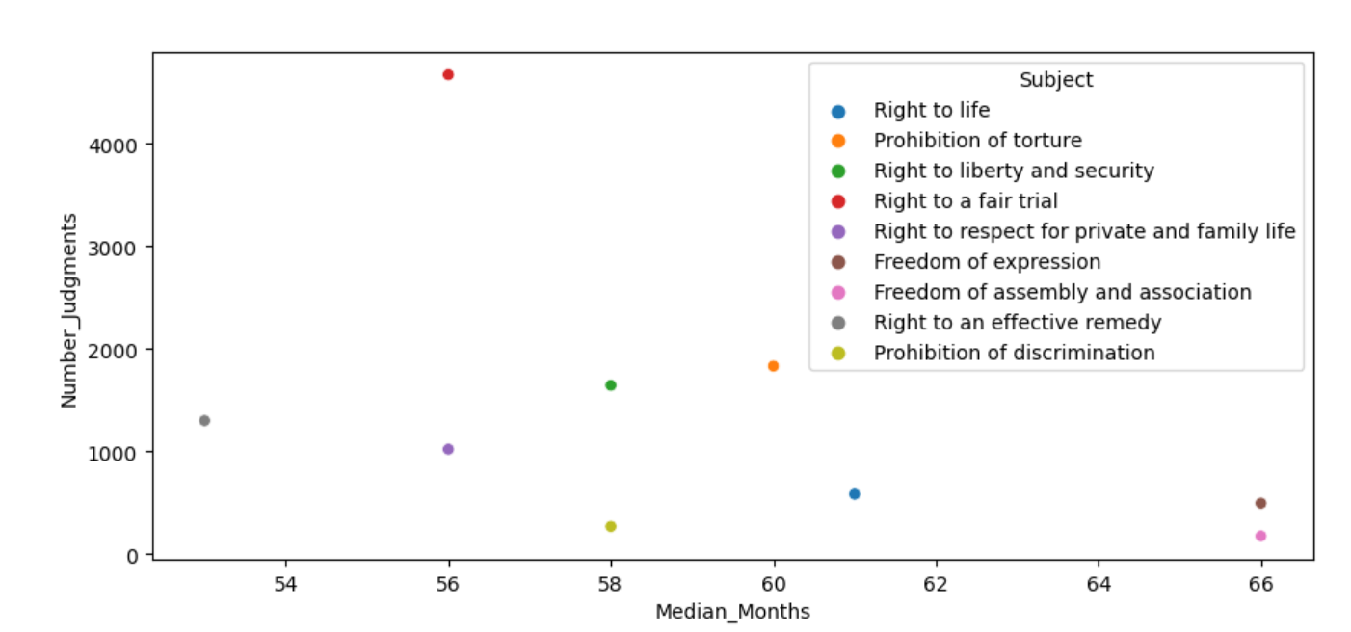
(Analysis)

Slide 34
Thank you

